Slide 1
Session 9: Figma, Vuexy, Practice Cut HTML
DucHV– 28th June 2021

Slide 2
Figma, Vuexy, Practice I
Contents
Figma
Vuexy
Cut HTML From Figma
Convert project via Vuexy

Slide 3

What is the figma?
How to get CSS, images from Figma
HTML to figma
Tips

Slide 4
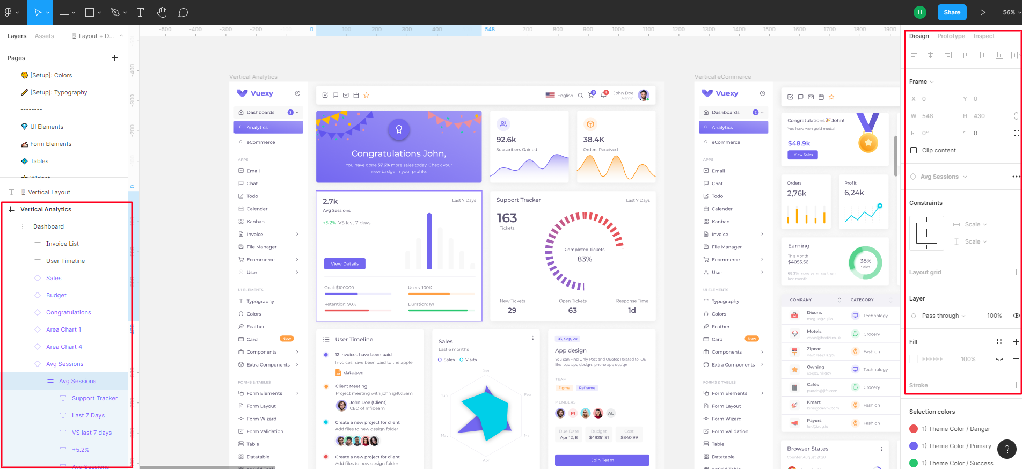
What is the Figma

Slide 5
What is the Figma
Figma is a cloud-based design tool that is similar to Sketch in functionality and features, but with big differences that make Figma better for team collaboration.
For those skeptical of such claims, we’ll explain how Figma simplifies the design process and is more effective than other programs at helping designers and teams work together efficiently.

Slide 6

View CSS code

Slide 7
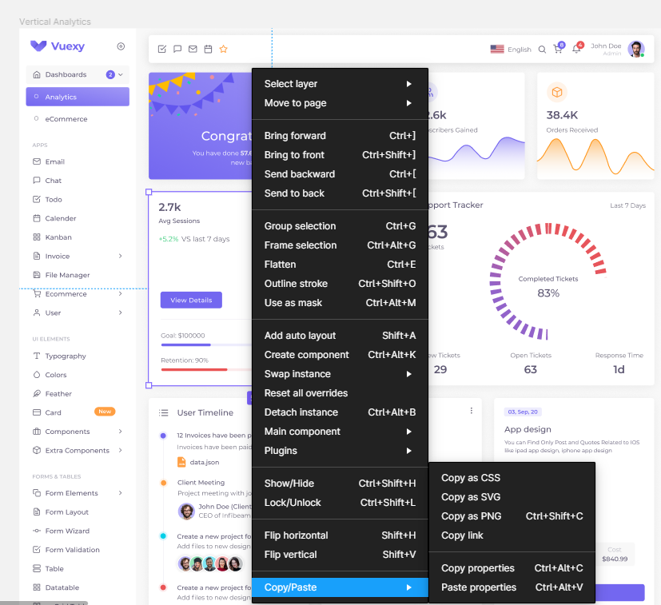
Copy CSS

Slide 8
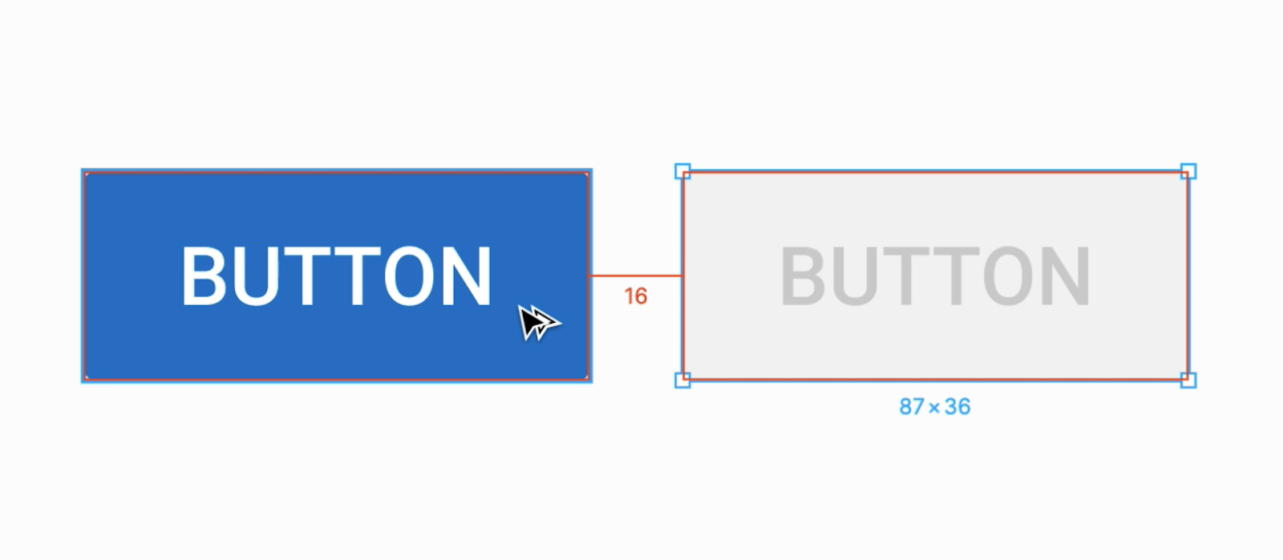
Padding

Slide 9
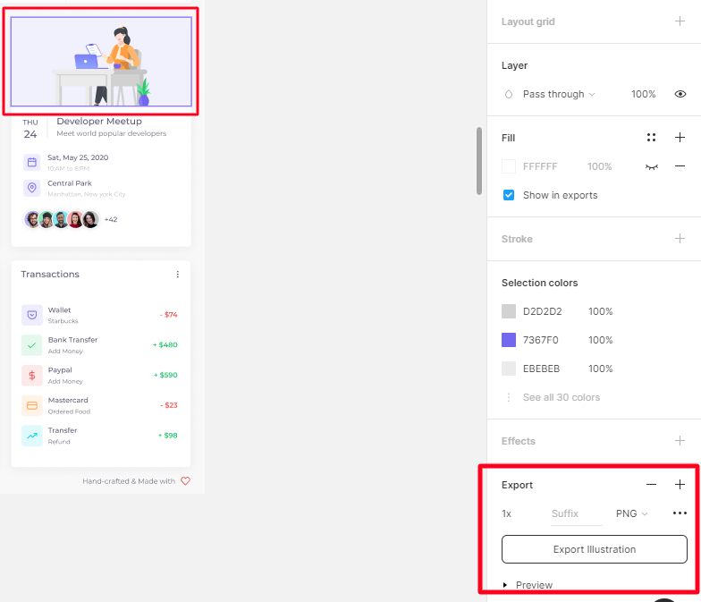
Export image

Slide 10

HTML to figma

Slide 11
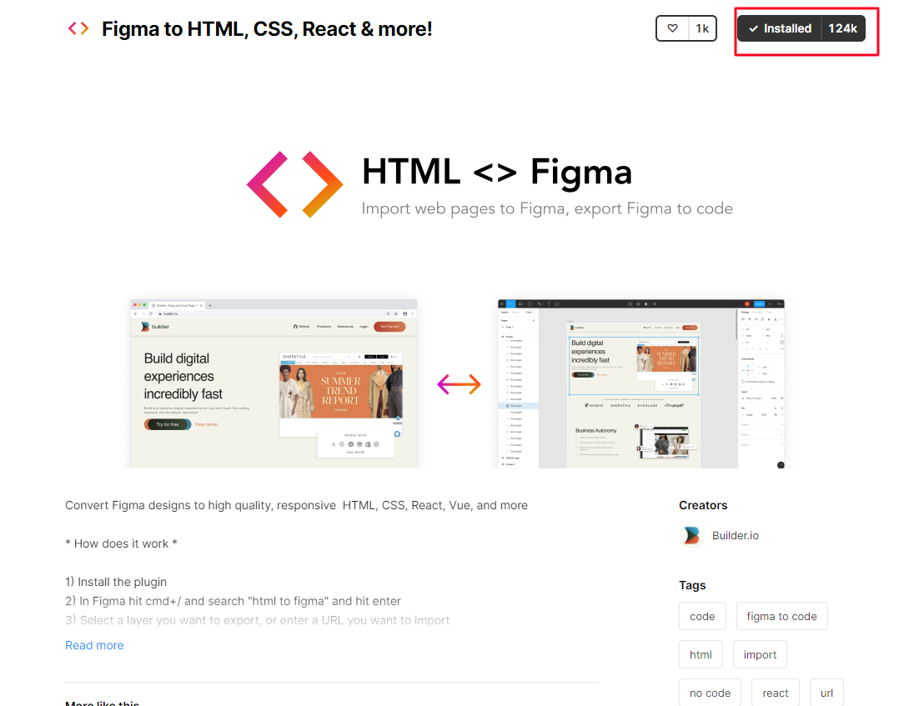
Install HTML to figma

Slide 12
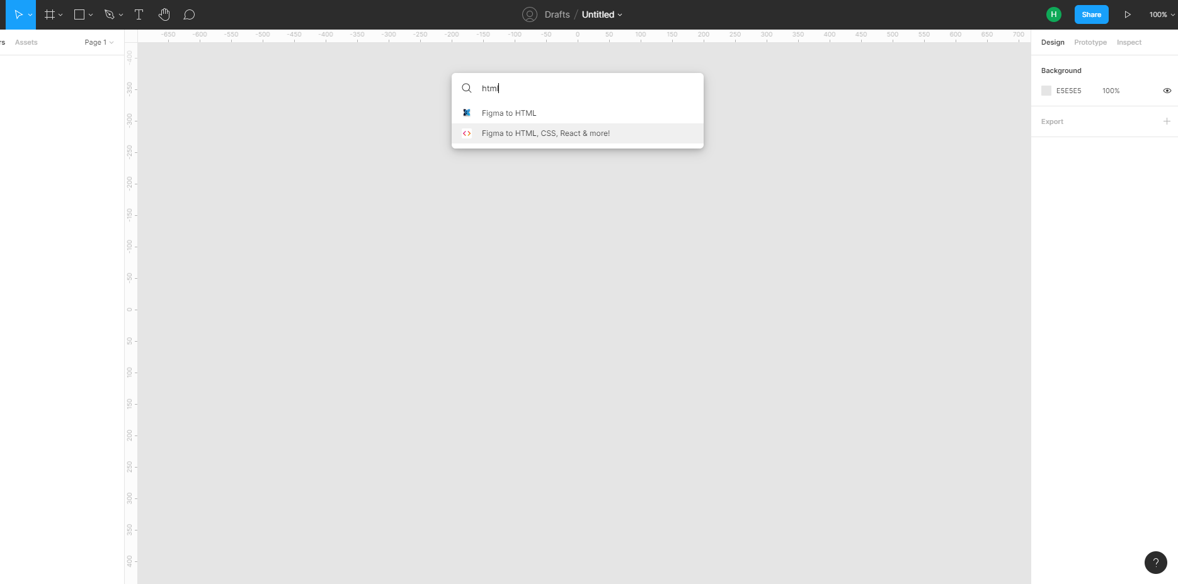
Find plugin

Slide 13
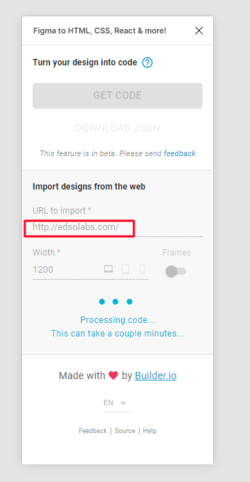
Import URL

Slide 14
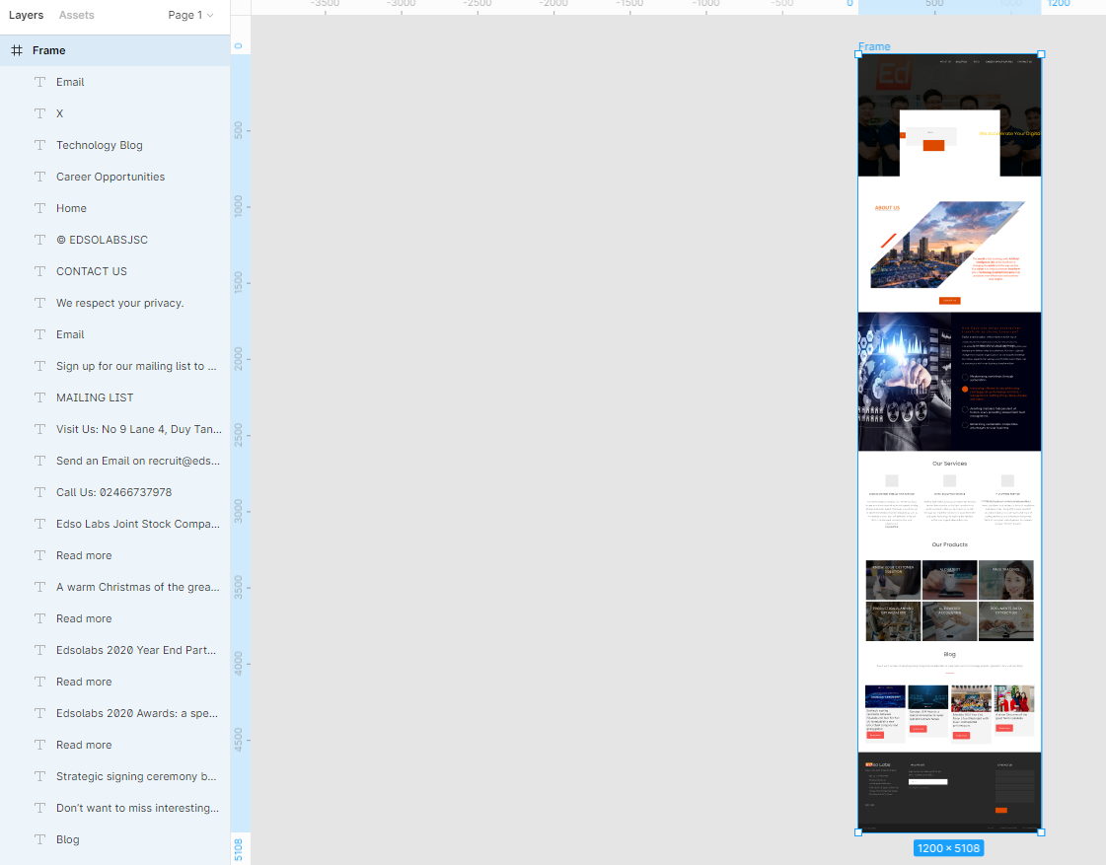
HTML to figma successful

Slide 15
Vuexy theme
What is the Vuexy theme?
Structure
Nameming
How to setup Vuexy
Note

Slide 16
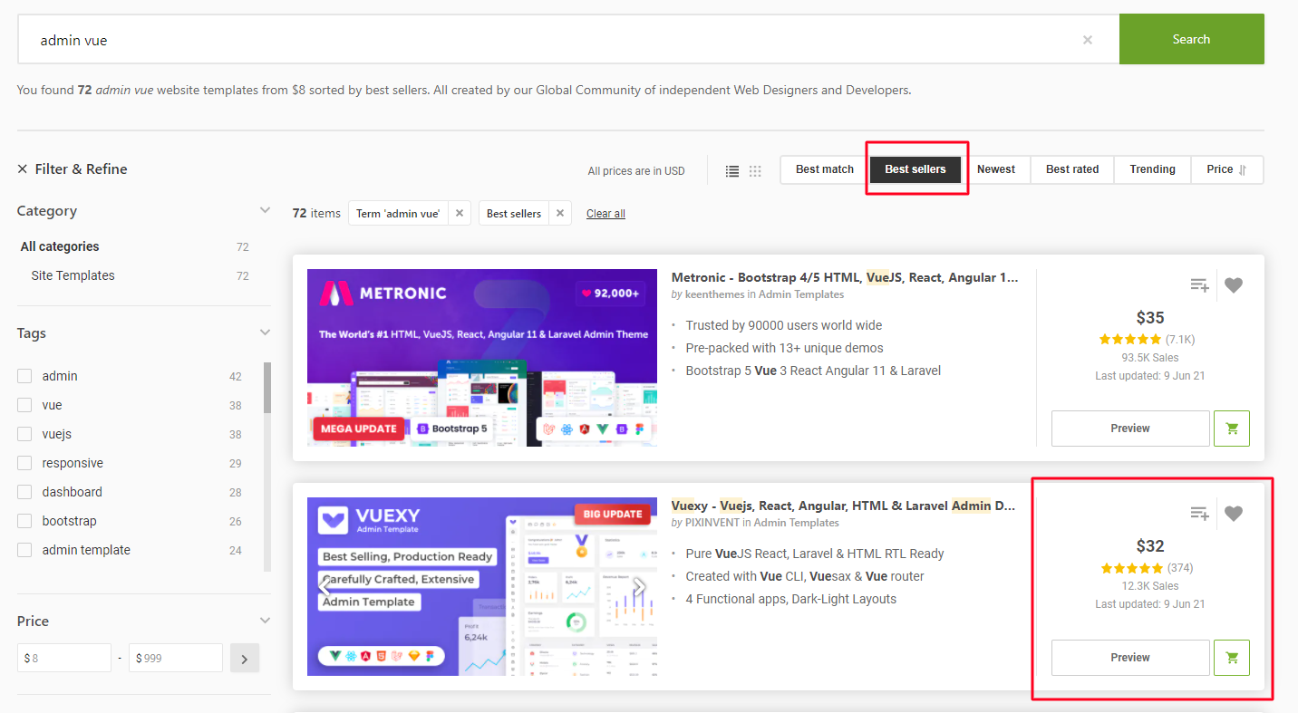
Vuexy theme

Slide 17
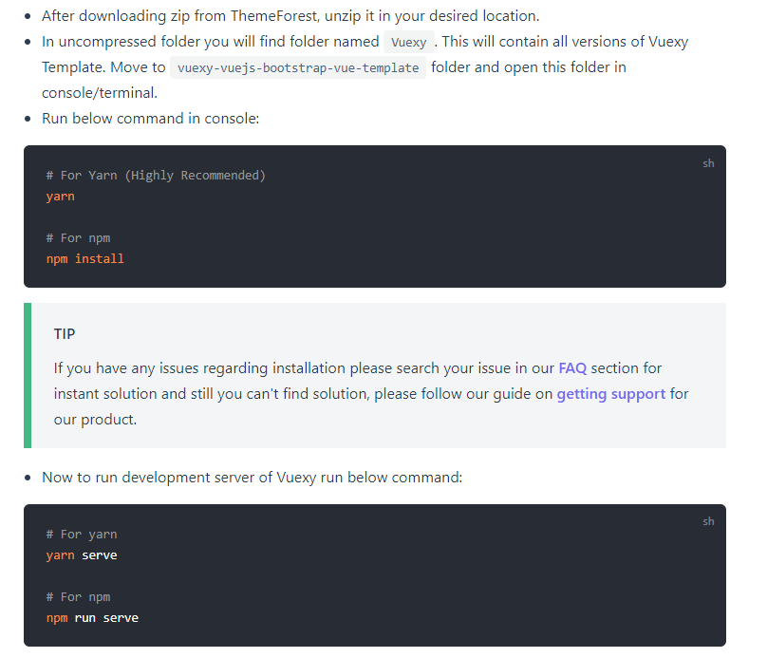
Install vuexy

Slide 18
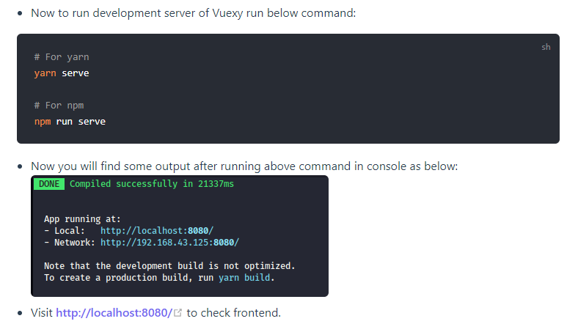
Install vuexy
successful

Slide 19
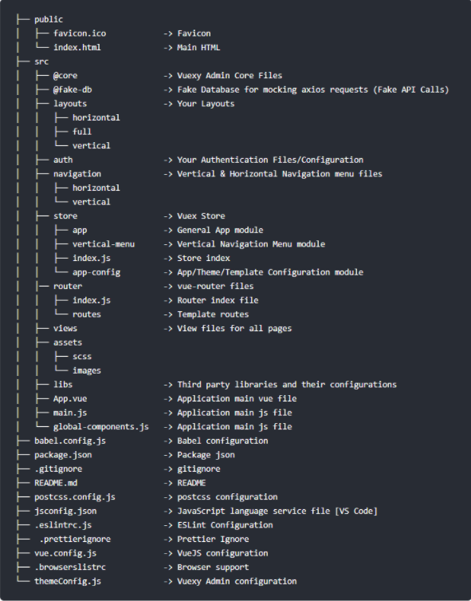
Structure

Slide 20
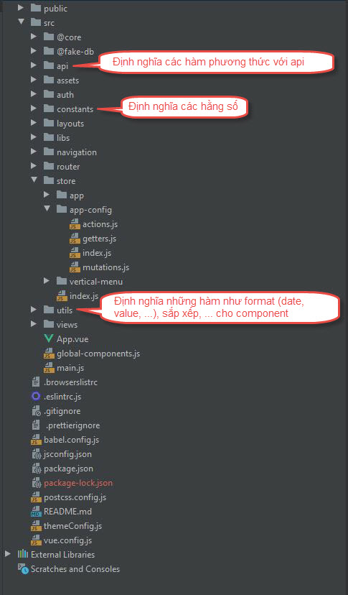
Structure

Slide 21
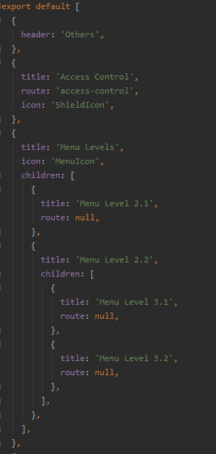
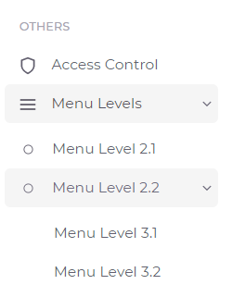
Navigation
In /src/navigation/vertical create trang-chu.js file
import in file index.js

Slide 22
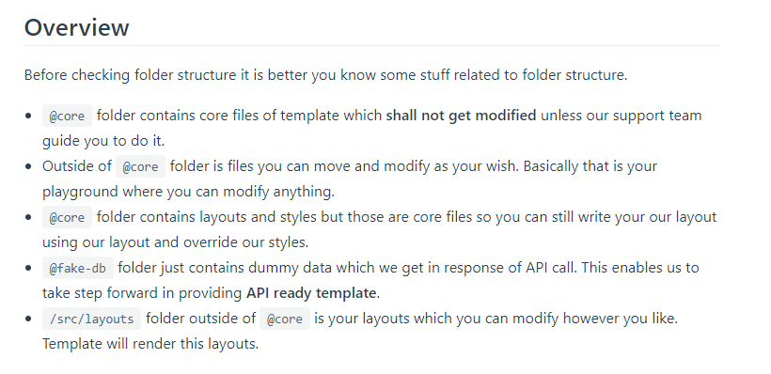
Overview notes

Slide 23
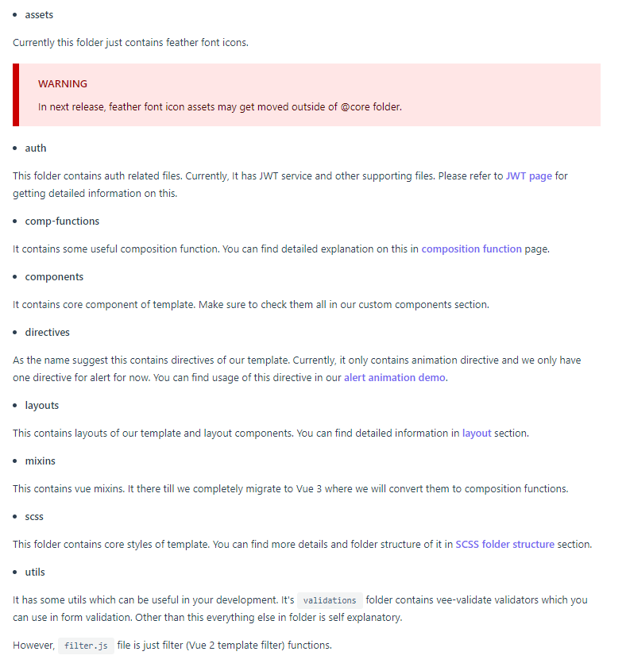
Folder meaning

Slide 24
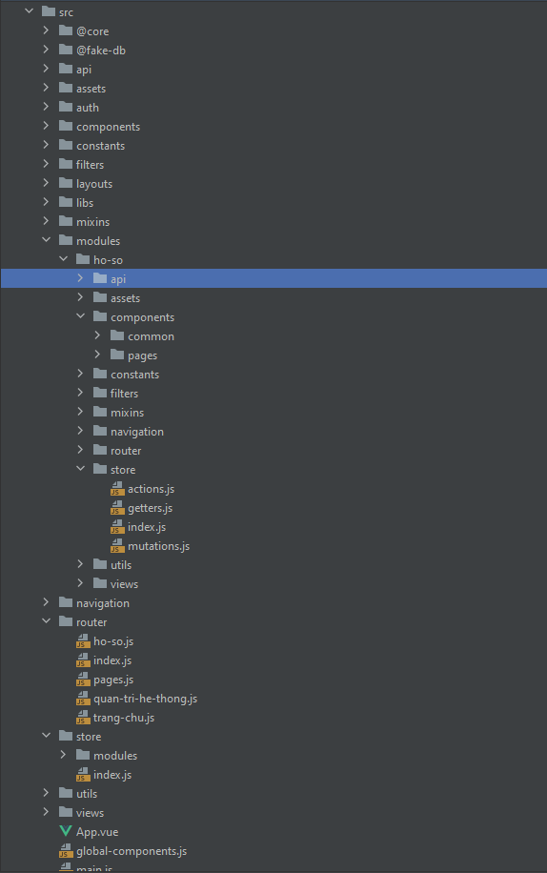
Folder Structure

Slide 25
Naming
1. Component name “PascalCase”. Ex: LeftMenu.vue, CalendarSideBar.vue, …
2. Function, method name “CamelCase”. Ex: getUser(), getList(), …
3. Constants name Ex: FORMAT_DATE, ROUTER_NAME, …
4. Folder name “kebab-case”. Ex: charts-and-maps, ui-elements, …
5. Component in template “keba-case”. Ex: <calendar-event-handler />, <feather-icon />, …

Slide 26
Practices

Slide 27
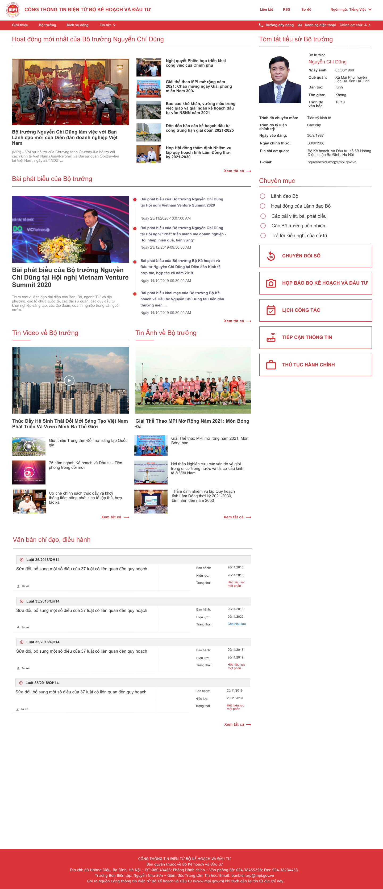
Cut HTML
From Figma

Slide 28
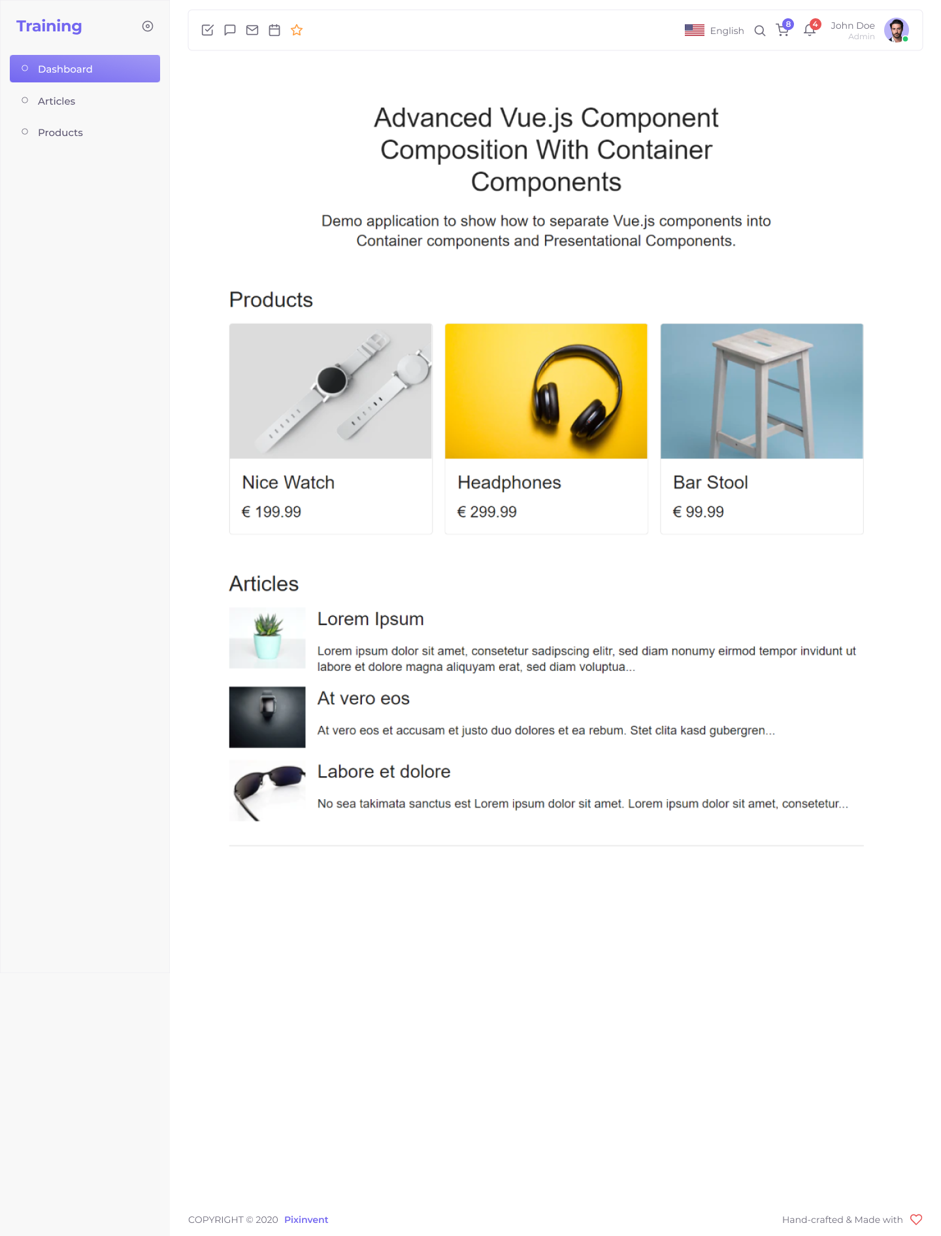
Convert project to Vuexy

Slide 29
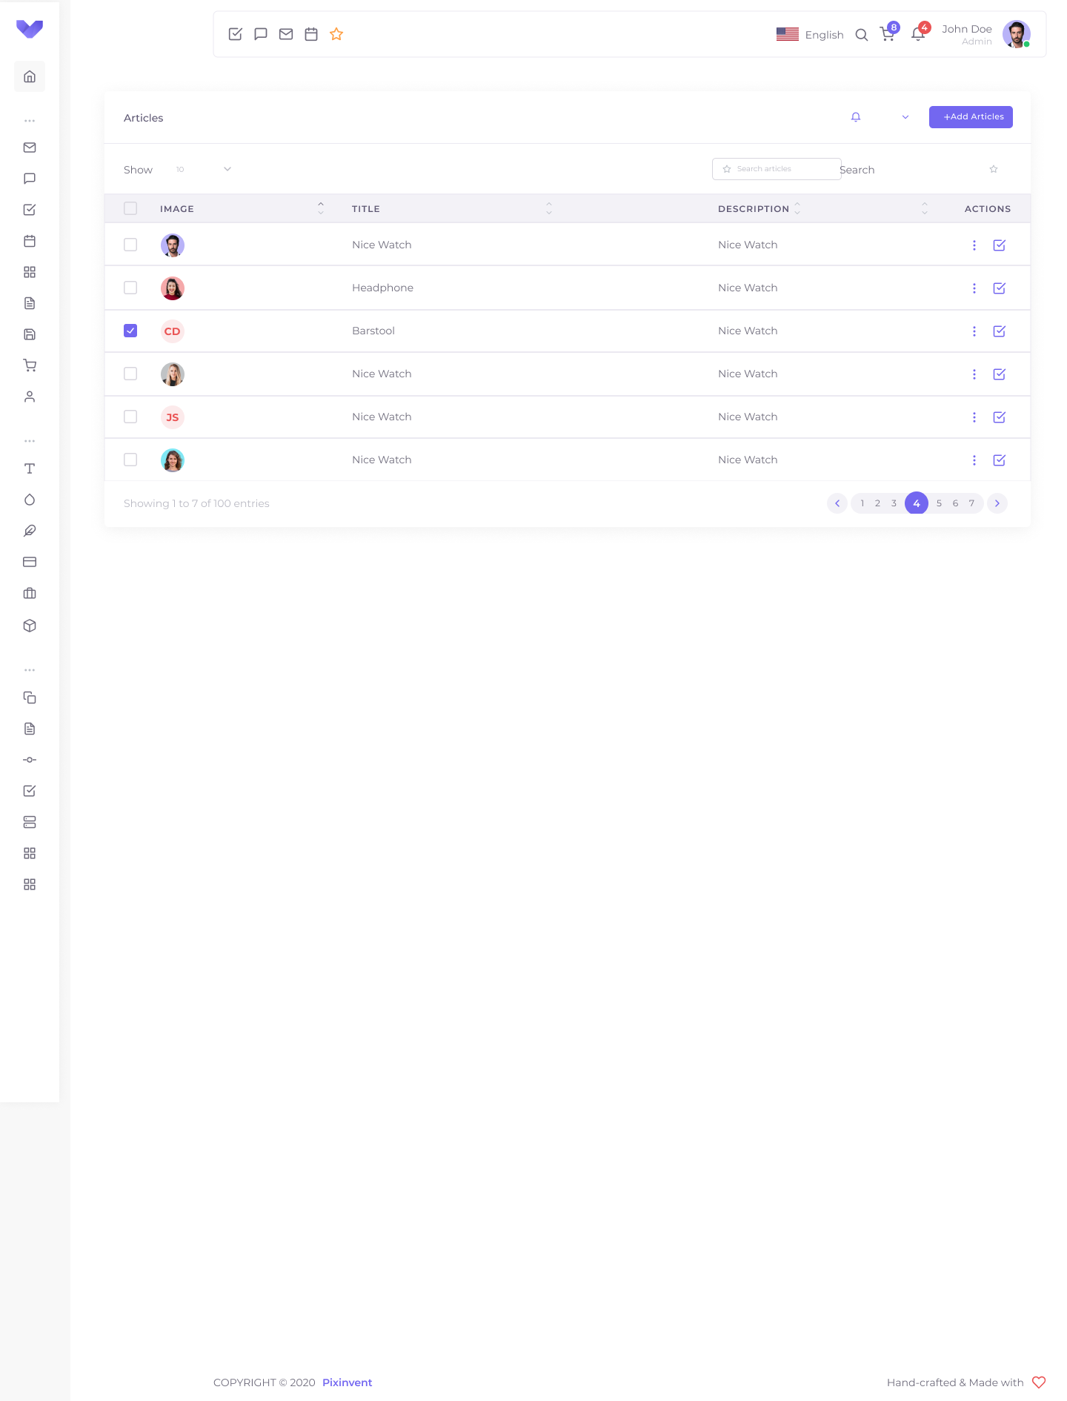
Convert project to Vuexy

Slide 30
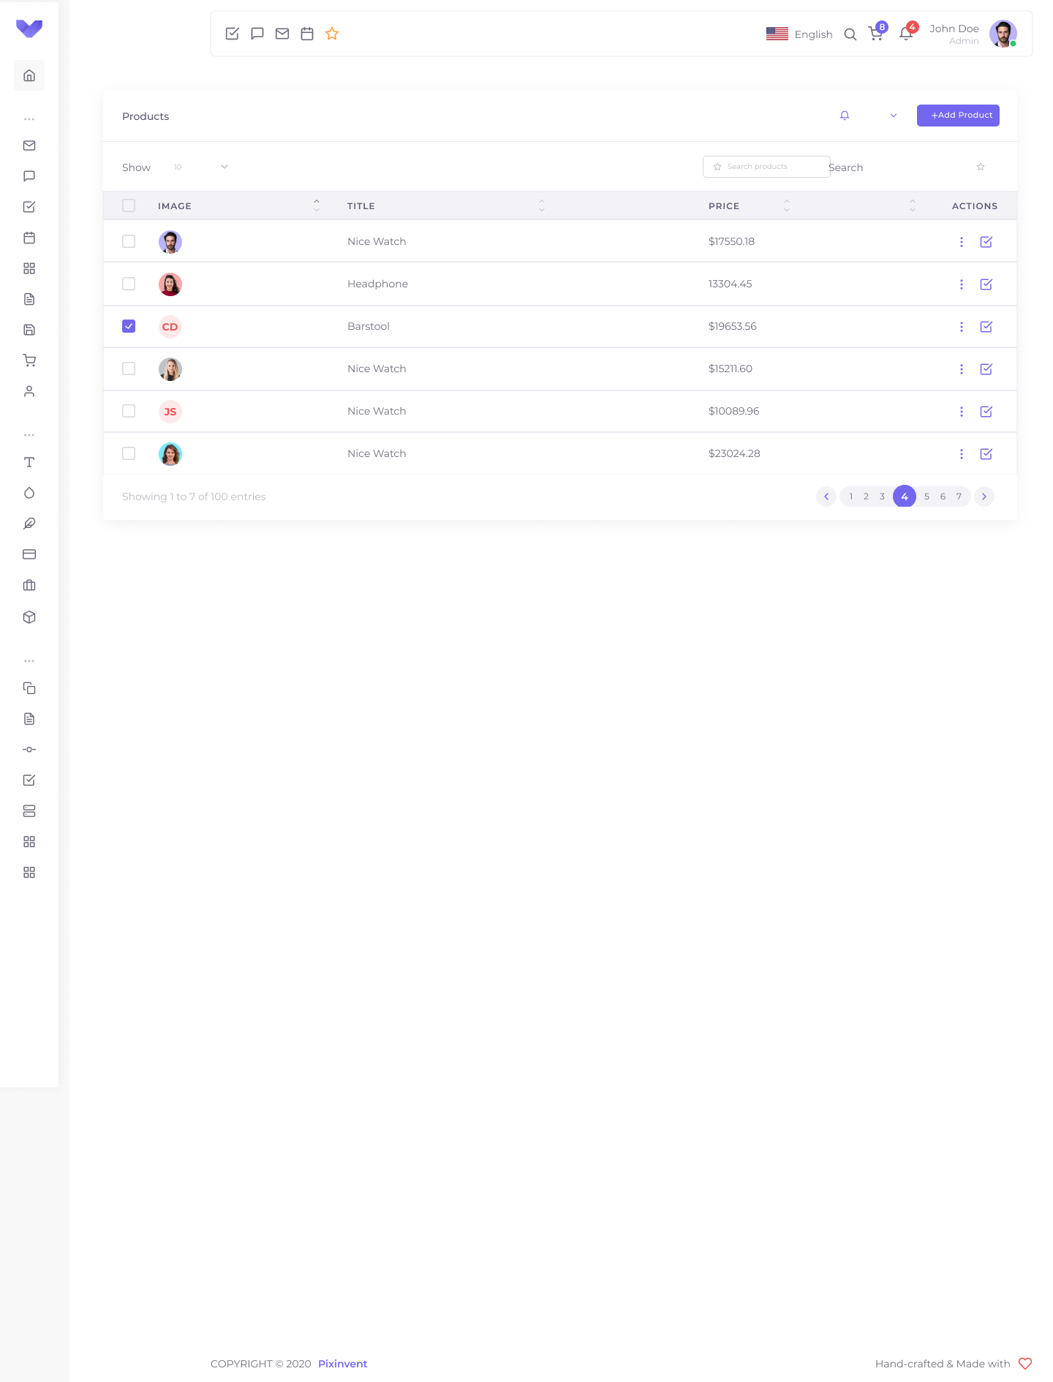
Convert project to Vuexy

Slide 31
Ref
https://www.figma.com/best-practices/tips-on-developer-handoff/
https://pixinvent.com/demo/vuexy-vuejs-admin-dashboard-template/demo-1/dashboard/ecommerce
https://pixinvent.com/demo/vuexy-vuejs-admin-dashboard-template/documentation/guide/#how-to-use-docs
https://www.figma.com/community/plugin/747985167520967365/Figma-to-HTML%2C-CSS%2C-React-%26-more!
https://telos.vn/figma-sau-hon-mot-nam-su-dung-cua-mot-ui-designer/
https://www.toptal.com/designers/ui/figma-design-tool

Slide 32
Thank you

